Slide 1
Statistics for Reporters
Randy Leonard
Digital frameworks
Northwestern University – Spring 2020
Github.com/randyleonard99/digitalframeworks-spring2020

Slide 2
Data stories?

Slide 3
Steps to a data story
Find data
Clean data
Analyze data
Present data

Slide 4
Guest: Sean McMinn, NPR
Examples
Statistical concepts you should know

Slide 5
Statistics for reporters
Summarize information
Mean, median, mode
Make comparisons/correlations
Averages/trends between groups
Make “predictions”
Use past data to predict future or missing data
**this is risky**

Slide 6
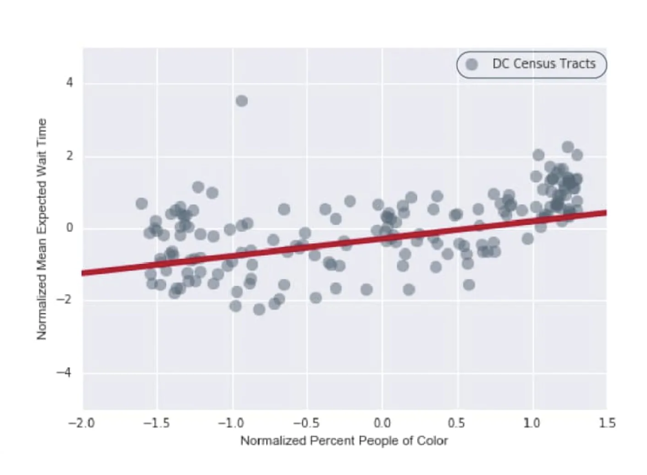
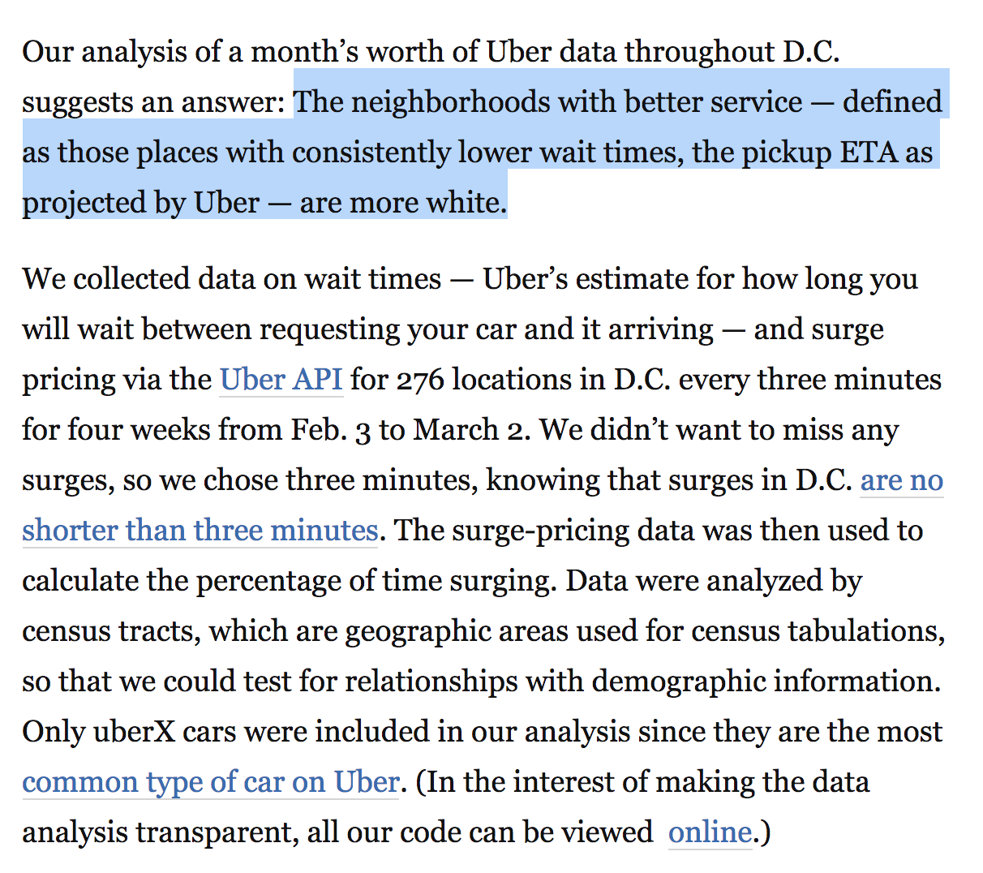
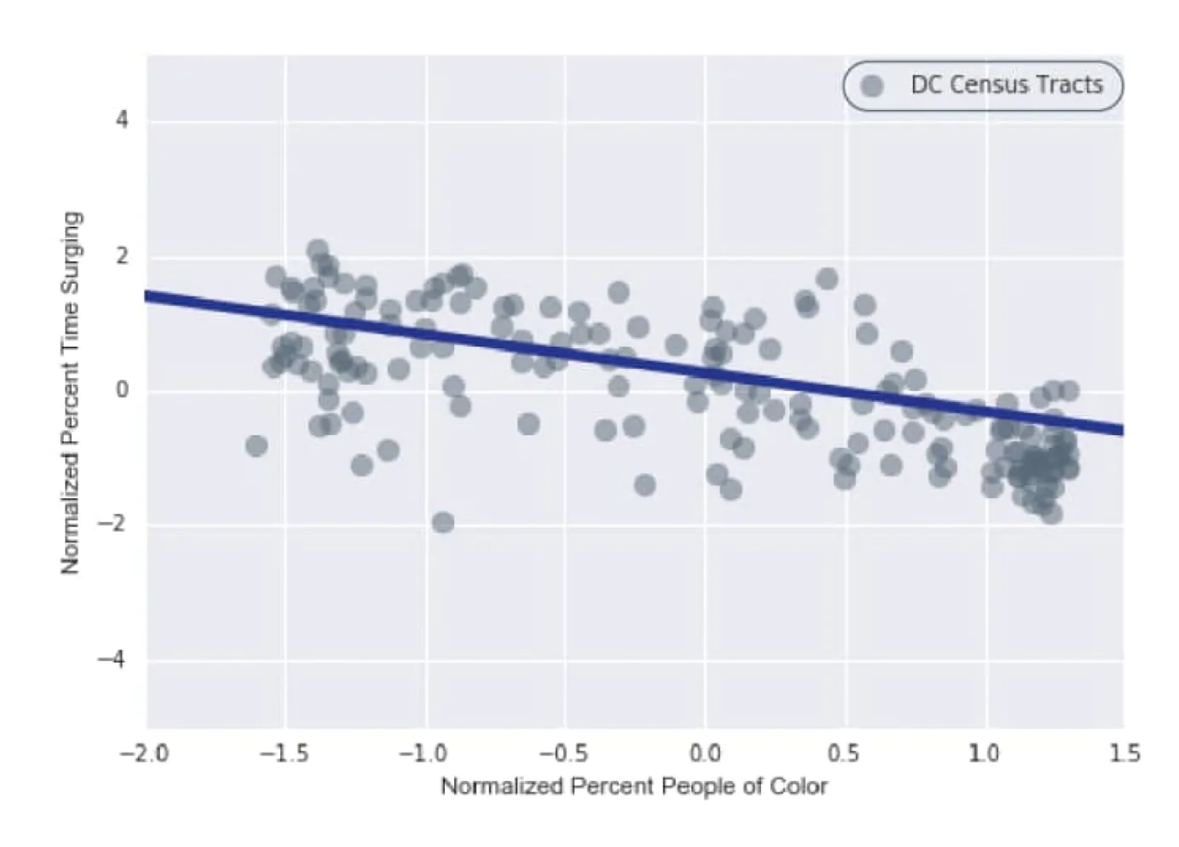
Stories with statistics
https://www.washingtonpost.com/news/wonk/wp/2016/03/10/uber-seems-to-offer-better-service-in-areas-with-more-white-people-that-raises-some-tough-questions/

Slide 7
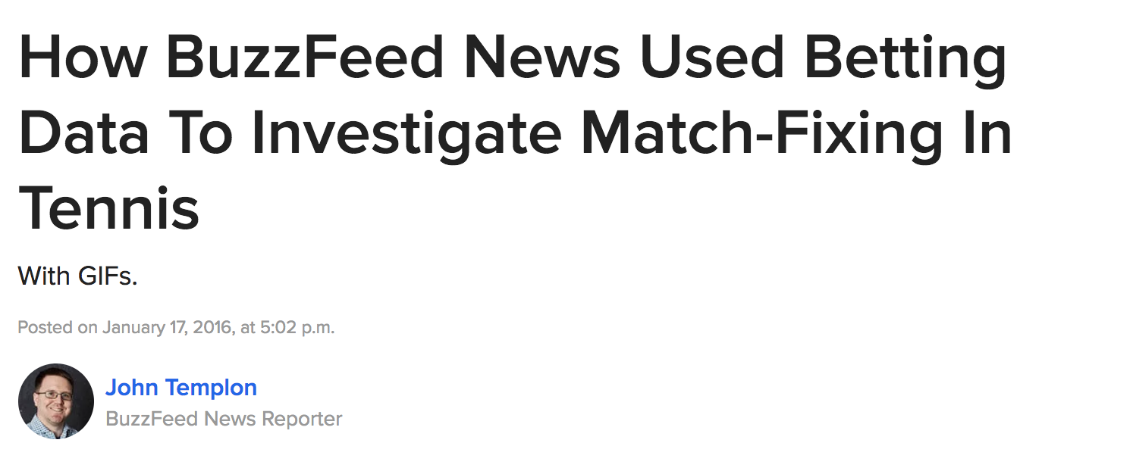

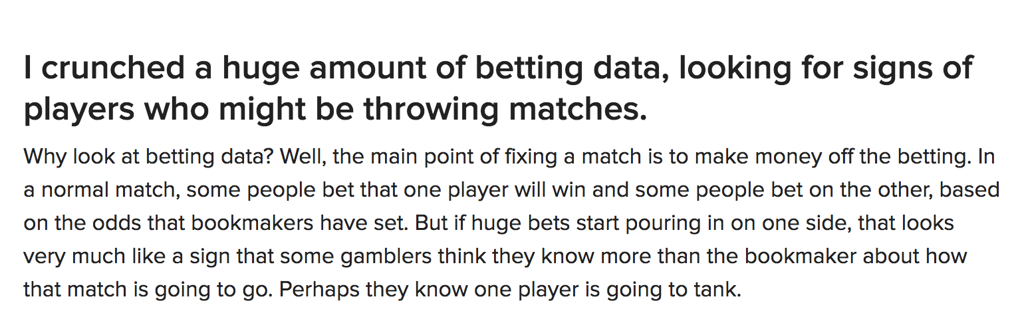
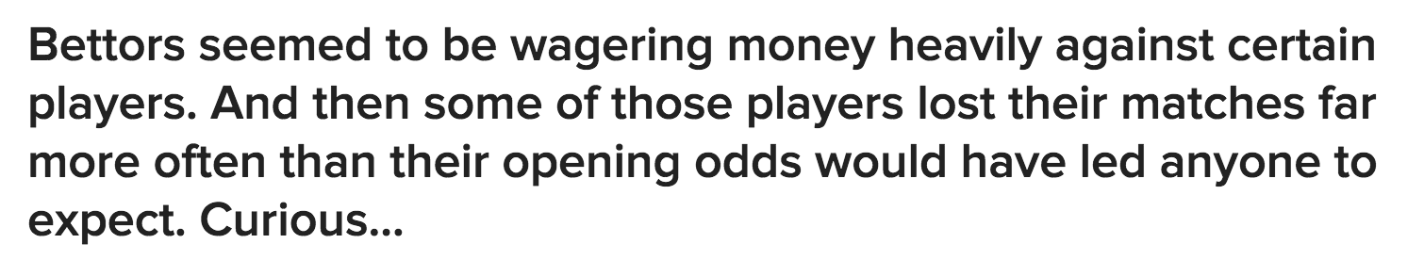
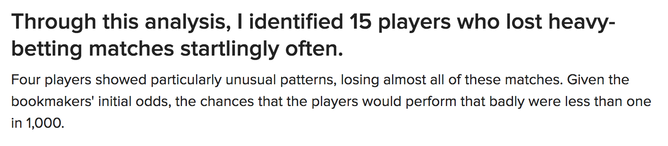
Stories with statistics
https://www.buzzfeed.com/heidiblake/the-tennis-racket?utm_term=.koRMg78M4#.fiob6VAbE

Slide 8
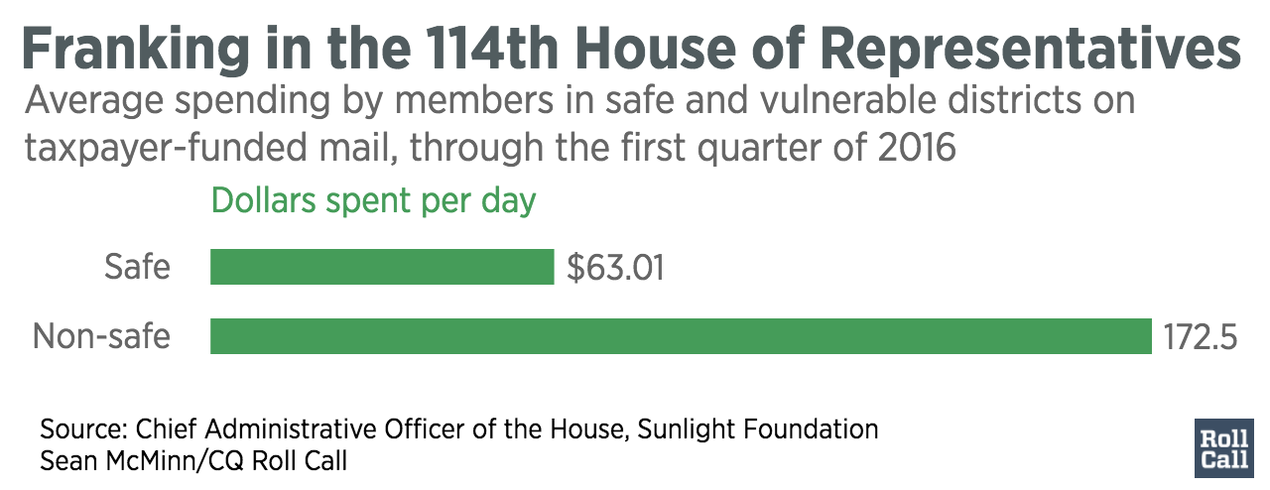
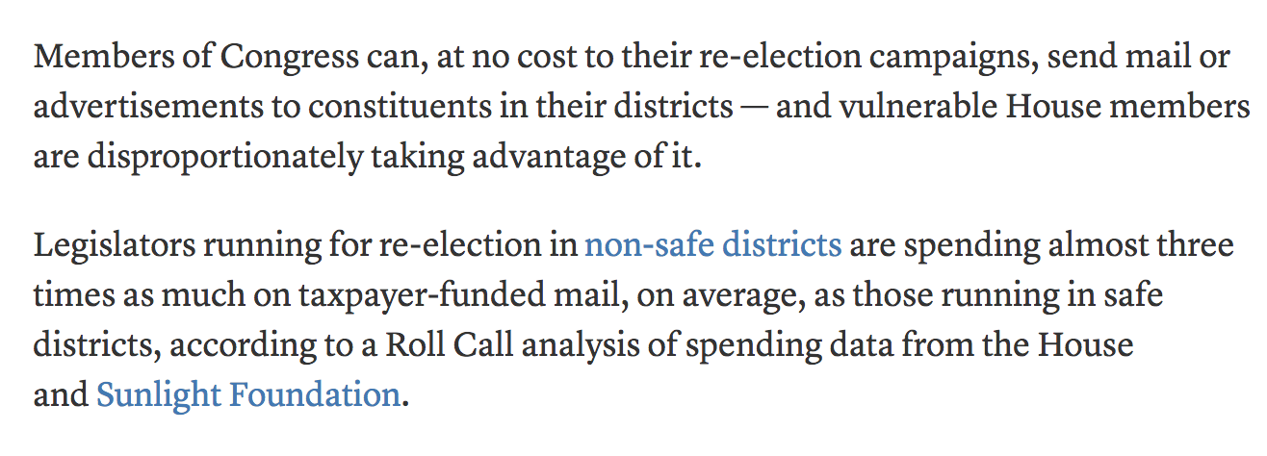
Stories with statistics
http://www.rollcall.com/news/house-members-can-send-mail-taxpayers-dime-vulnerable-ones-much-much

Slide 9
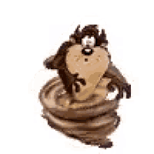
Whirlwind of statistics
For reporters!

Slide 10
Descriptive statistics
1+2+6+7+9+12+14
Mean
Average
Median
= 7.29
7
1,2,6,7,9,12,14

Slide 11
Descriptive statistics
When to use each?

Slide 12
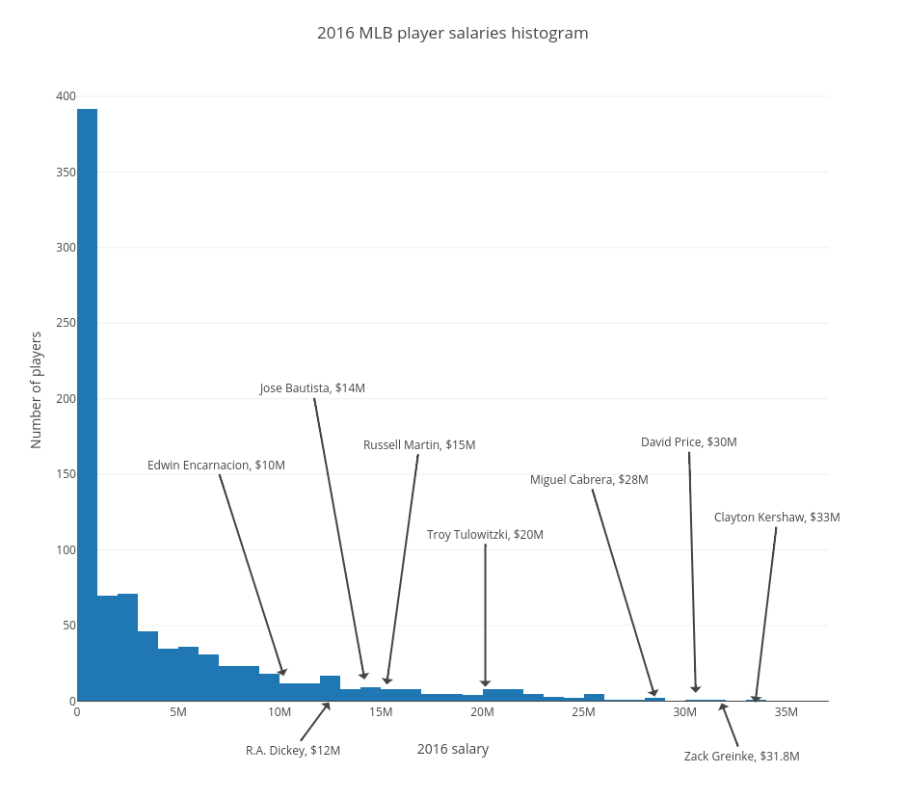
Descriptive statistics
Mean is generally a good bet
Unless …

Slide 13
Descriptive statistics
If data is skewed, mean is not robust to outliers, and will be heavily influenced by them
Instead, use median — which is robust to outliers
~median
~average

Slide 14
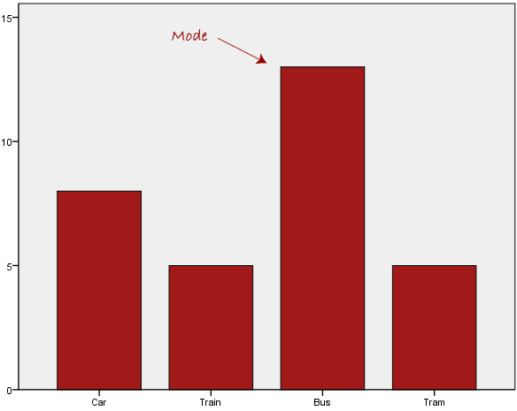
Descriptive statistics
Other descriptive statistics
Mode: most common value
Be careful: mode does not equal “most” or “majority” – more often means “plurality”

Slide 15
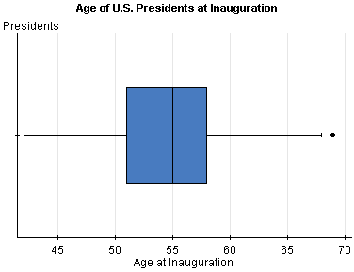
Descriptive statistics
Other descriptive statistics
Quantiles: Range of first quarter of data, second quarter of data, etc…
End of second quantile is also median!

Slide 16
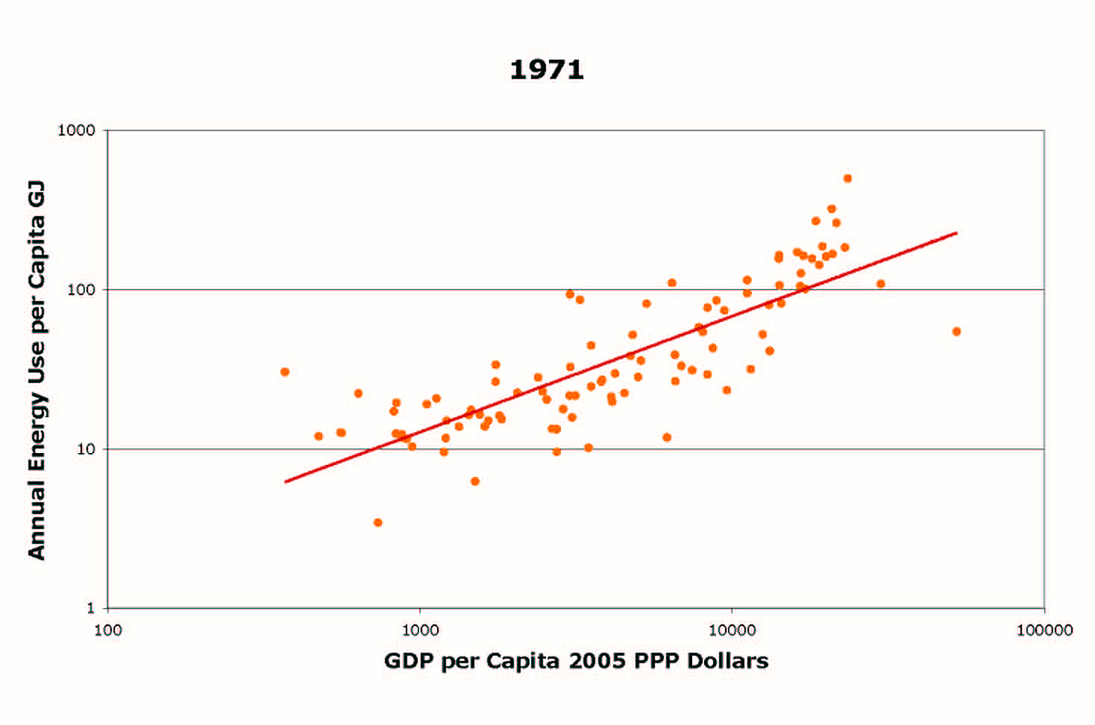
Regression/inference
Can’t survey/sample everybody
Notes:
That’s why if you do the same study a bunch of times, you’ll get somewhat different results. You have to choose some sample to look at and apply it to the whole population

Slide 17
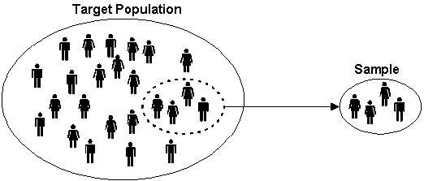
Regression/inference
This is what polling is all about
Use sample mean to infer population mean

Slide 18
Activity
You are a severe migraine patient in an NIH study. Every day, you have a 5005 chance of getting a migraine.
Researchers are keeping track of how many migraines you get each week.
Flip a coin five times – this is your migraines during a given week. Go tape it on the whiteboard in the correct column.
Do this four more times to represent five weeks of data.

Slide 19
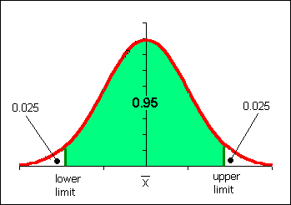
Activity
We should see something like this: a normal distribution.

Slide 20
Activity
Now let’s say that with a new treatment, patients get an average of 1 migraine every 2 weeks

Slide 21
Activity
This difference would be considered statistically significant – it’s so far away from the norm that it’s very unlikely to have happened if the treatment didn’t do anything

Slide 22
Activity
Now let’s say that with a new treatment, patients get an average of 2 migraines every 2 weeks

Slide 23
Activity
This difference would NOT be considered statistically significant – it’s close enough to the norm that it’s reasonably likely to have happened EVEN IF the treatment didn’t do anything

Slide 24
P values
.09
P value: how far from the tail of the chart your new mean is
But p-value is hard to explain, and easy to manipulate
https://www.facebook.com/fivethirtyeight/videos/1014409165269579/

Slide 25
P values
Not all results in studies are statistically significant – and not all statistically significant results are significant in reality.

Slide 26

Correlations
Correlation DOES NOT EQUAL causation
Need an experiment, not observational survey, to do that

Slide 27
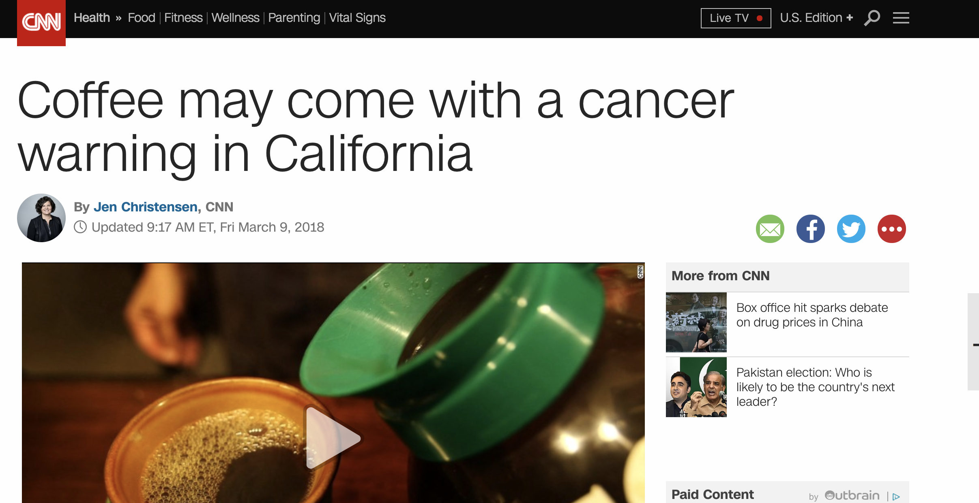
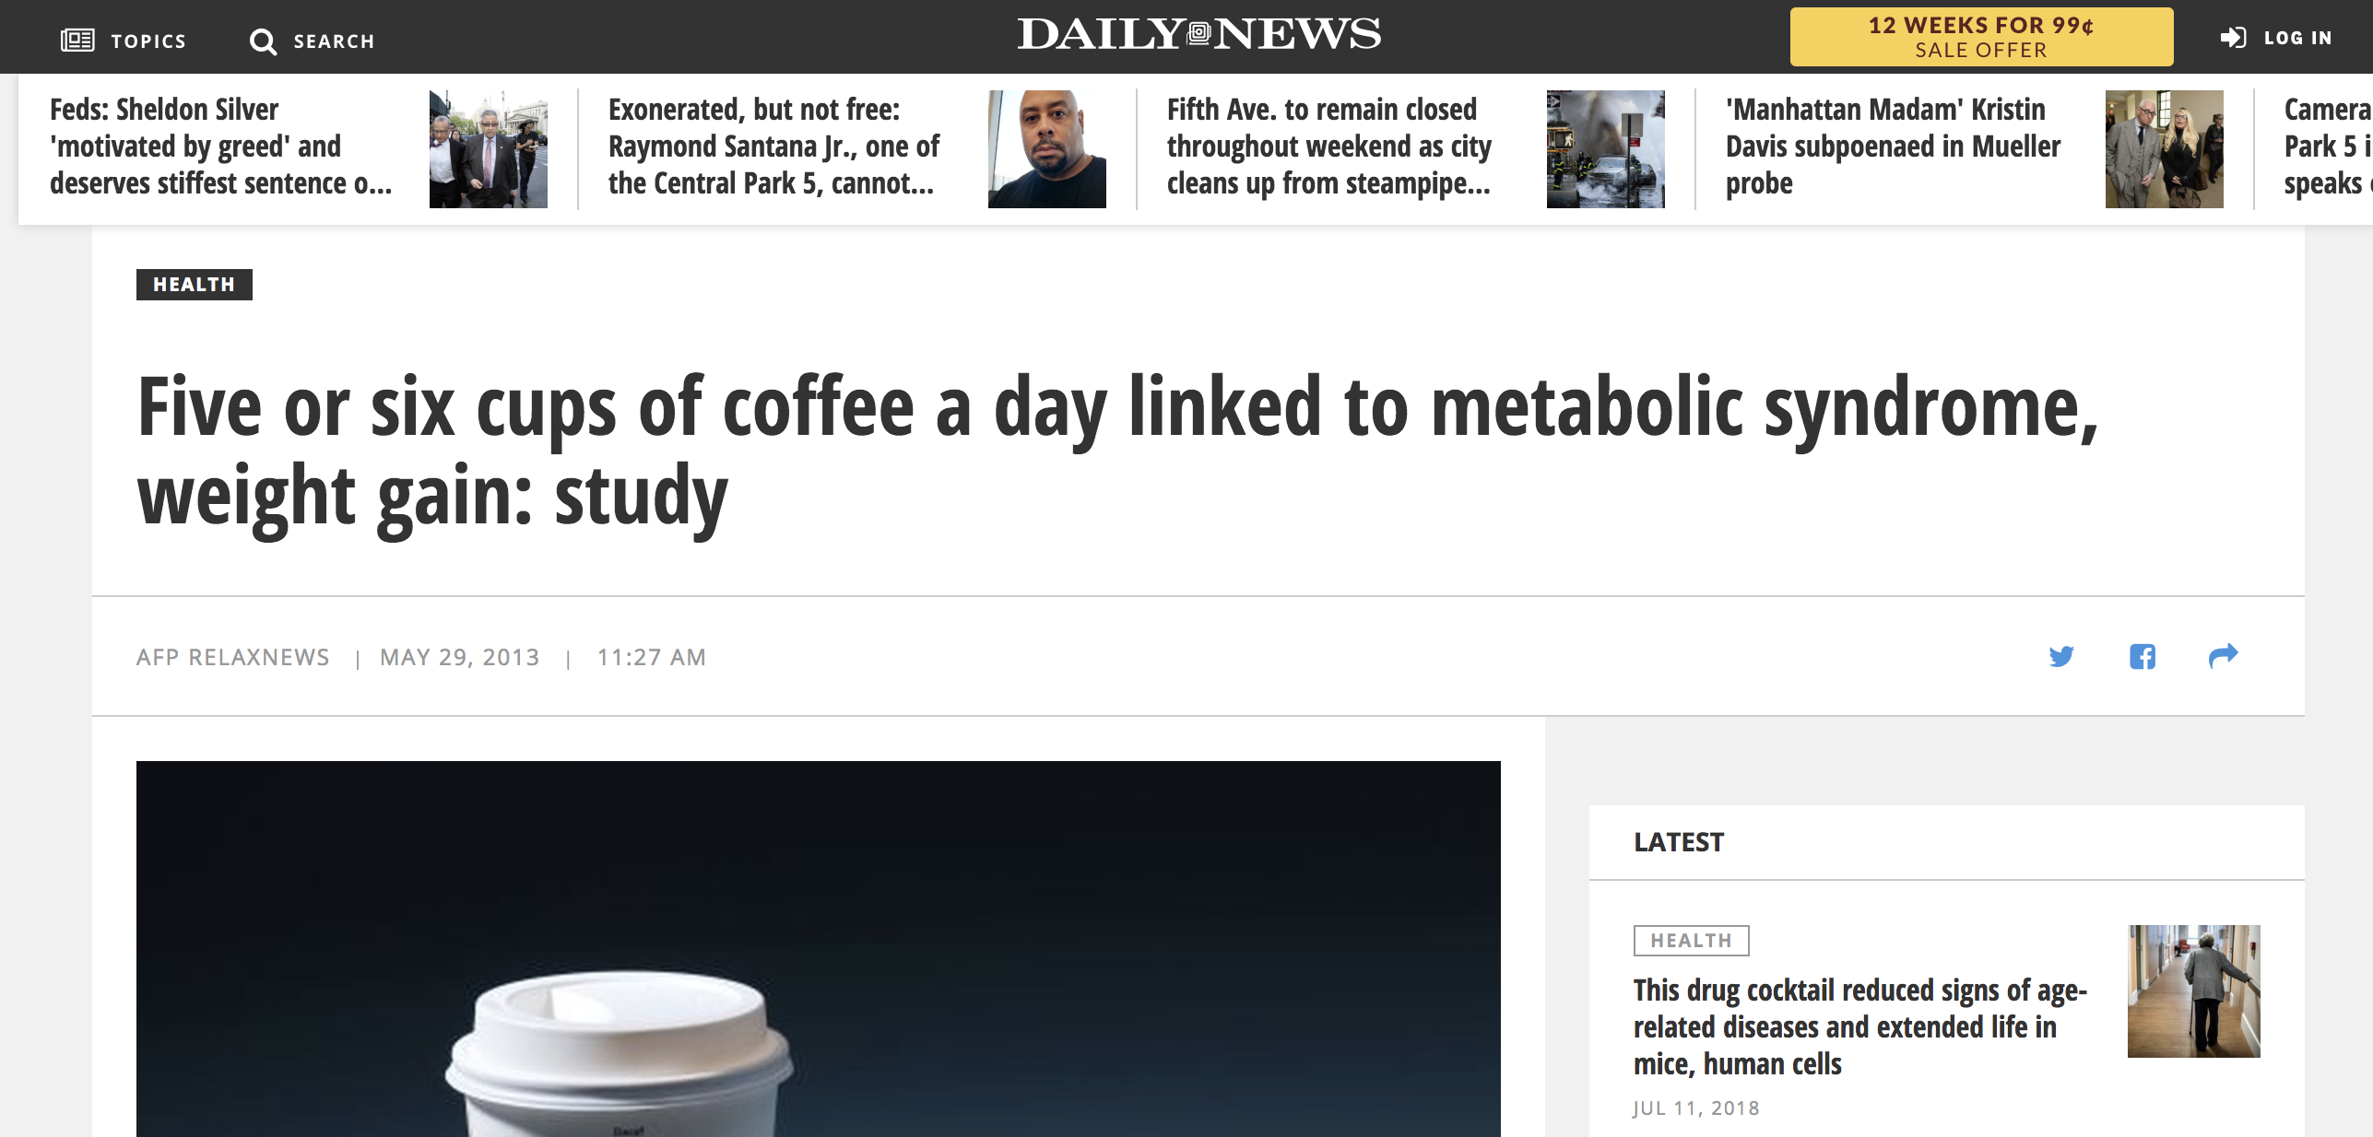
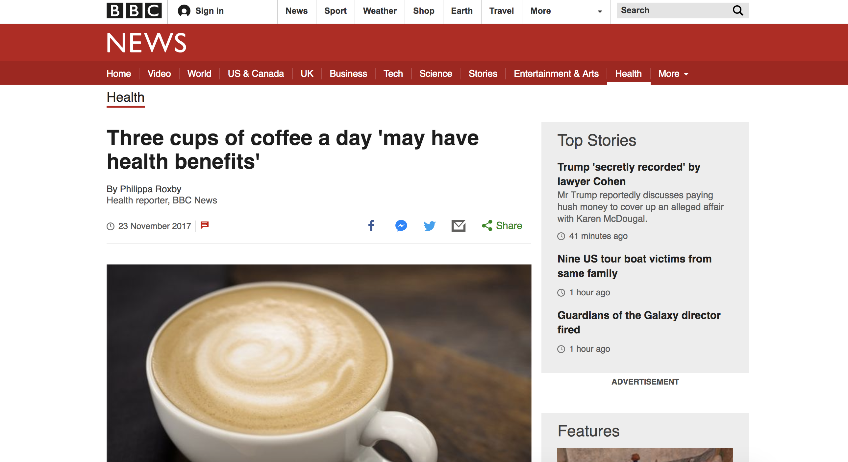
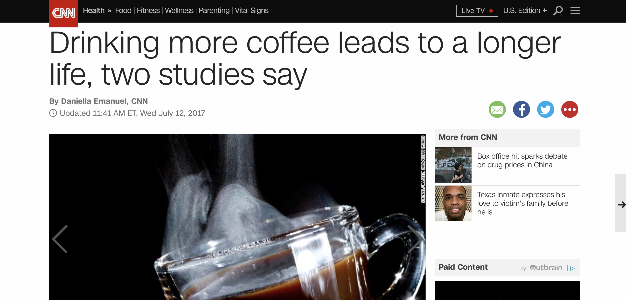
Correlations

Slide 28
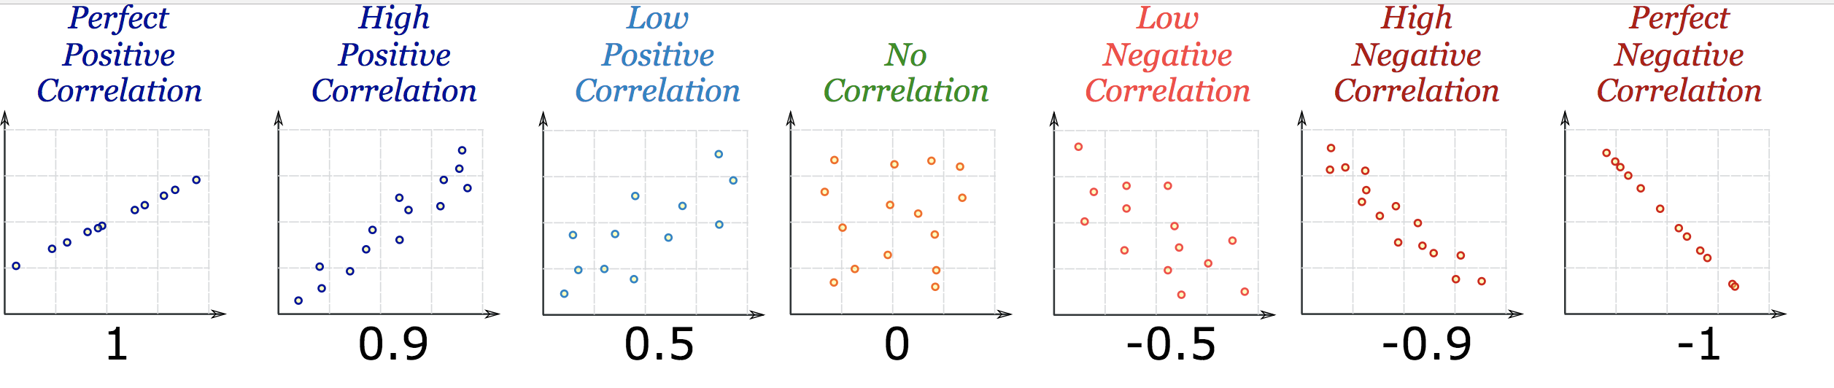
Correlations

Slide 29
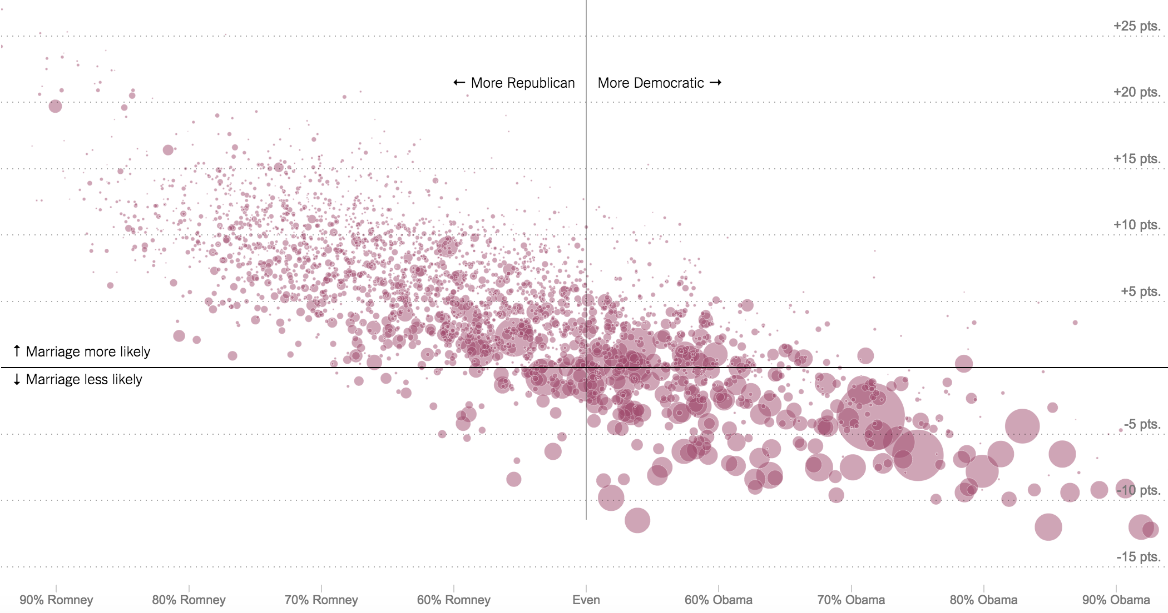
Correlations
What kind of correlation
b/w Democrats and marriage rates?

Slide 30
Correlations
Strong negative correlation

Slide 31
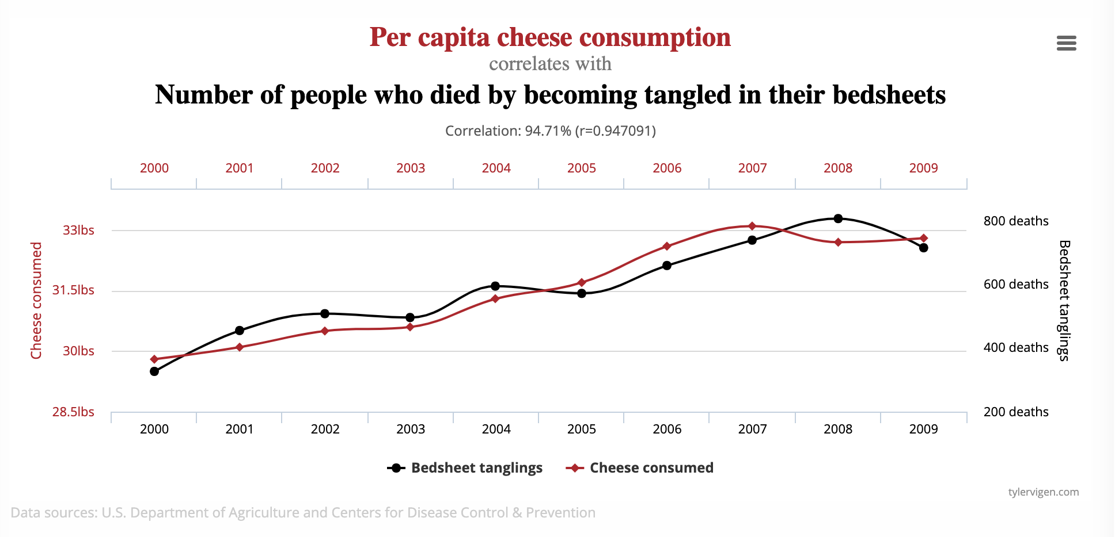
Correlations
Correlations

Slide 32
Correlations
Correlations

Slide 33
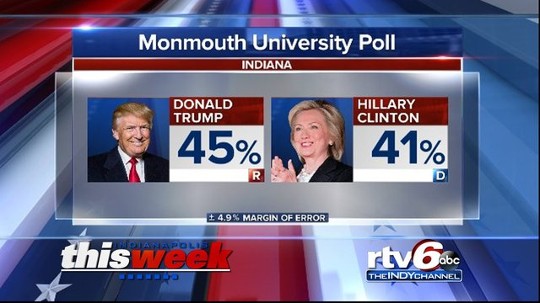
Margin of error
Standard is to have 95 percent threshold

Slide 34
Margin of error
What determines the margin of error
Bigger sample (number of people polled)
Lower/higher margin of error?
Higher certainty requirement (i.e. 95% vs 90%)
Lower/higher margin of error?

Slide 35
Margin of error
What determines the margin of error
Bigger sample (number of people polled)
Lower/higher margin of error?
Higher certainty requirement (i.e. 95% vs 90%)
Lower/higher margin of error?

Slide 36
Regression/inference
So how do we describe this?
45%
40.1%
49.9%
We are 95 percent confident the true percentage of all voters supporting Trump is somewhere between 40.1 and 49.9

Slide 37
Random sample
Without a random sample, nothing else matters because bias!
Probably not random

Slide 38
Random sample
Talk with partner about how these non-random samples could introduce bias
To get monthly grocery spending habits, you survey everyone who stops at the Giant fancy cheese station
To gauge Chicago residents’ position on green energy, you survey every third person who walks by the Navy Pier
To gauge America’s reaction to Trump’s press conference, Breitbart.com puts a poll on its home page

Slide 39
Random sample
Better (but not always practical):
To get monthly grocery spending habits, I use a computer to randomly generate list of 75 shoppers I’ll talk to as they leave the store ( 18th, 22nd, 38th, etc)
To gauge Chicago residents’ position on green energy, I randomly select 200 addresses from the phone book then go to interview the occupants
To gauge America’s reaction to Trump’s press conference, I use random-digit dialing to call 500 Americans

Slide 40
Writing about Stats
To make a very small number more understandable, divide it into 1. For example, .0081 is the proportion of the U.S. population who die every year. 1/.0081 translates to 1 in every 124 Americans die each year.
Limit yourself to no more than 12 digits, including dates such as 2012, in a single paragraph.
-Sarah Cohen, data editor NYT

Slide 41
Writing about Stats
Add context as a proportion of the whole: “At the time of the Million Man March in 1995, a turnout of 1 million black men would have represented 1/12th of all the black men in the country at the time.”
Put things in scale: https://www.youtube.com/watch?v=aKrFFFpYgkU

Slide 42
Percentages
Calculating percentage changes and HELP YOUR COLLEAGUES!
New - old
OR
change
old
old

Slide 43
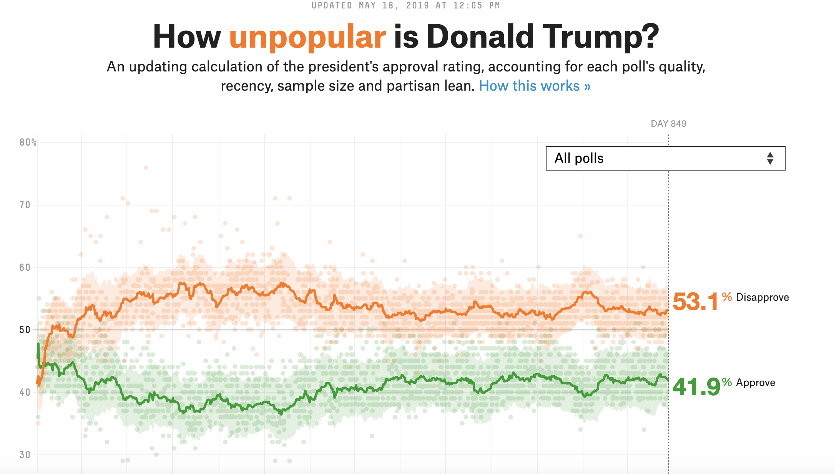
Percentages
Consider changes: percent vs. percent points
Trump approval rating 18 months ago: 37.2%
Trump approval rating last weekend: 41.9%
+12.6% change
+4.7 pct pts. change

